Slide 1
Design of Engineering Experiments
Chapter 2 – Some Basic Statistical Concepts
Describing sample data
  Random samples
  Sample mean, variance, standard deviation
  Populations versus samples
  Population mean, variance, standard deviation
  Estimating parameters
Simple comparative experiments
  The hypothesis testing framework
  The two-sample t-test
  Checking assumptions, validity
Chapter 2
Design & Analysis of Experiments 8E 2012 Montgomery

Slide 2
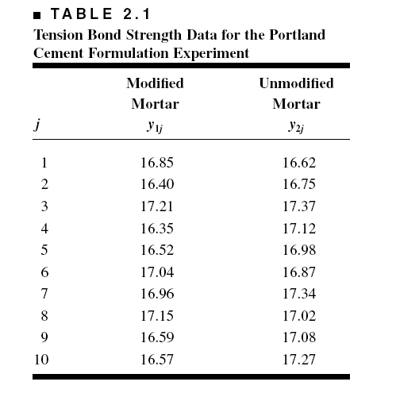
Portland Cement Formulation (page 26)
Chapter 2
Design & Analysis of Experiments 8E 2012 Montgomery

Slide 3
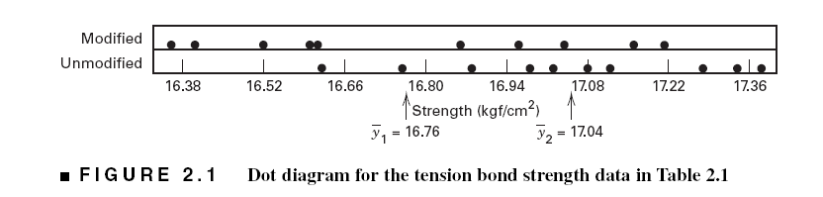
Graphical View of the Data
Dot Diagram, Fig. 2.1, pp. 26
Chapter 2
Design & Analysis of Experiments 8E 2012 Montgomery

Slide 4
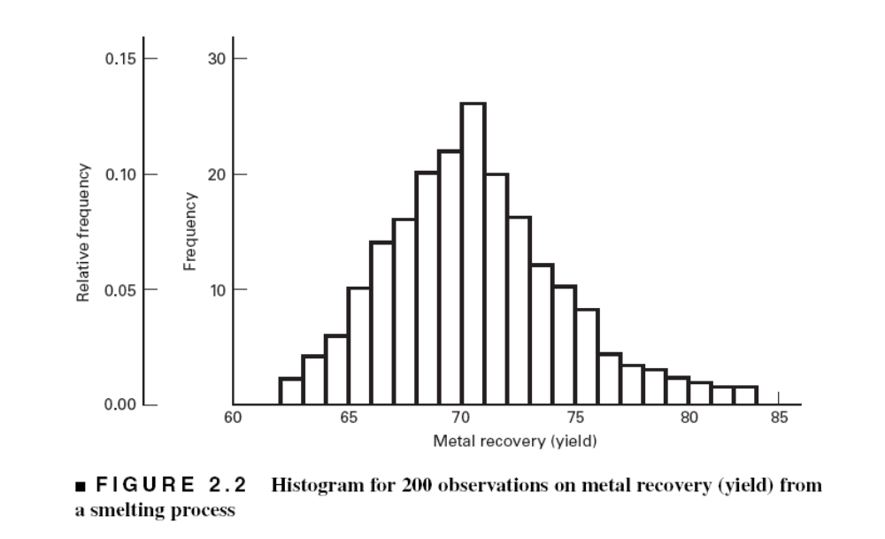
If you have a large sample, a histogram may be useful
Chapter 2
Design & Analysis of Experiments 8E 2012 Montgomery

Slide 5
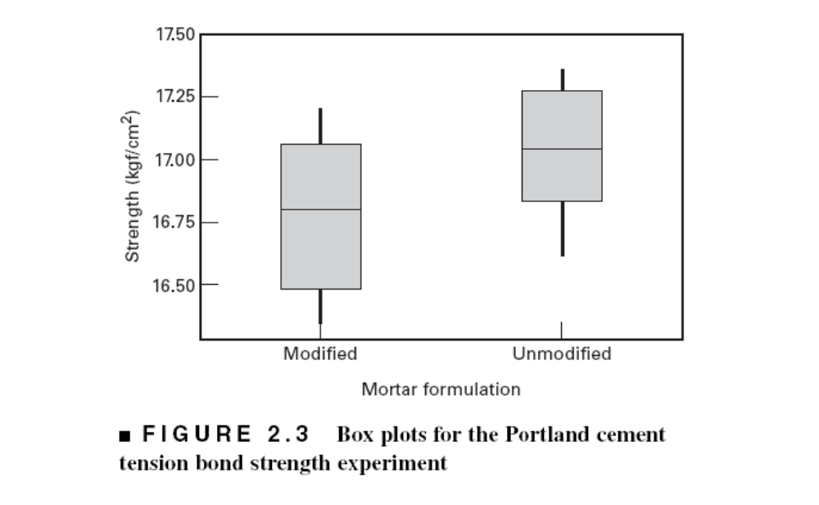
Box Plots, Fig. 2.3, pp. 28
Chapter 2
Design & Analysis of Experiments 8E 2012 Montgomery

Slide 6
The Hypothesis Testing Framework
Statistical hypothesis testing is a useful framework for many experimental situations
Origins of the methodology date from the early 1900s
We will use a procedure known as the two-sample t-test
Chapter 2
Design & Analysis of Experiments 8E 2012 Montgomery

Slide 7
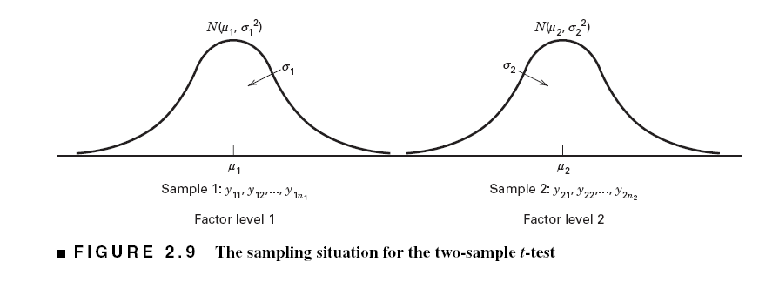
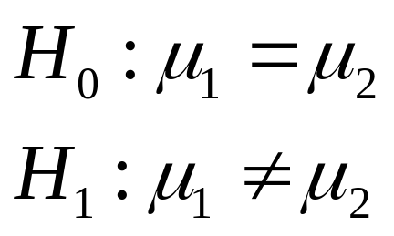
The Hypothesis Testing Framework
Sampling from a normal distribution
Statistical hypotheses:
Chapter 2
Design & Analysis of Experiments 8E 2012 Montgomery

Slide 8
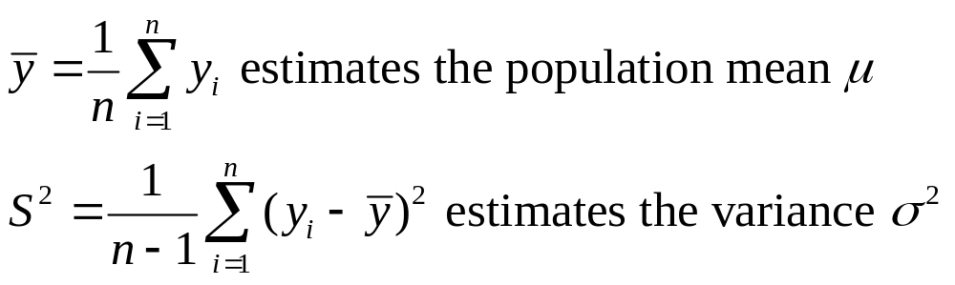
Estimation of Parameters
Chapter 2
Design & Analysis of Experiments 8E 2012 Montgomery

Slide 9
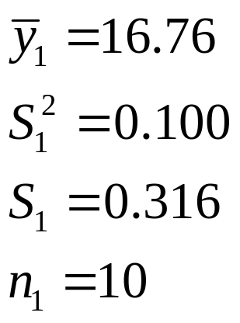
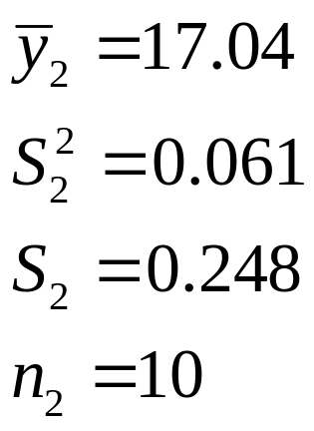
Summary Statistics (pg. 38)
Modified Mortar
“New recipe”
Unmodified Mortar
“Original recipe”
Chapter 2
Design & Analysis of Experiments 8E 2012 Montgomery

Slide 10
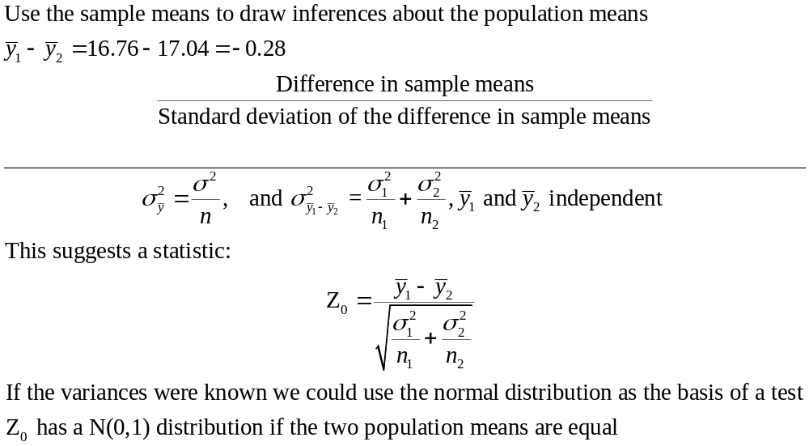
How the Two-Sample t-Test Works:
Chapter 2
Design & Analysis of Experiments 8E 2012 Montgomery

Slide 11
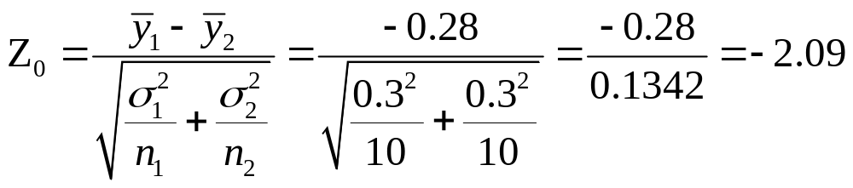
If we knew the two variances how would we use Z₀ to test H₀?
Suppose that σ₁ = σ₂ = 0.30. Then we can calculate
How “unusual” is the value Z₀ = -2.09 if the two population means are equal?
It turns out that 95% of the area under the standard normal curve (probability) falls between the values Z_{0.025} = 1.96 and - Z_{0.025} = -1.96.
So the value Z₀ = -2.09 is pretty unusual in that it would happen less that 5% of the time if the population means were equal
Chapter 2
Design & Analysis of Experiments 8E 2012 Montgomery

Slide 12
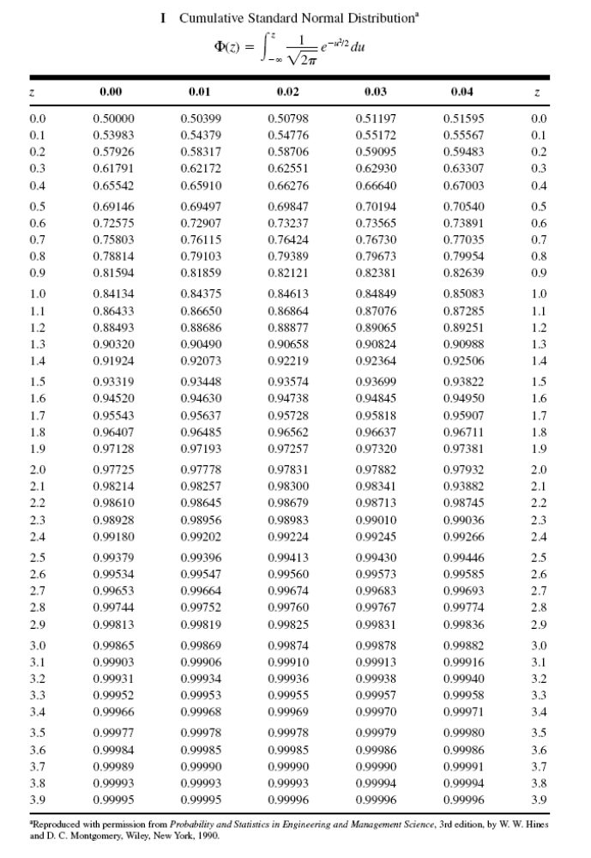
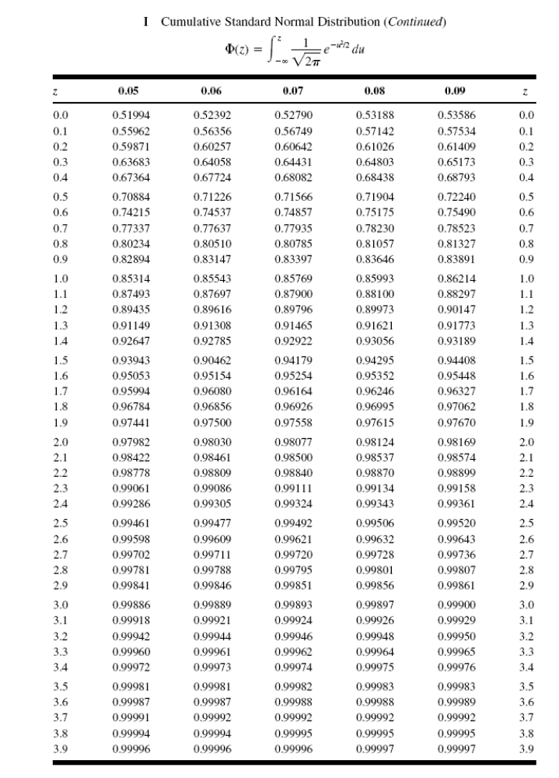
Standard Normal Table (see appendix)
Z_{0.025} = 1.96
Chapter 2
Design & Analysis of Experiments 8E 2012 Montgomery

Slide 13
So if the variances were known we would conclude that we should reject the null hypothesis at the 5% level of significance
and conclude that the alternative hypothesis is true.
This is called a fixed significance level test, because we compare the value of the test statistic to a critical value (1.96) that we selected in advance before running the experiment.
The standard normal distribution is the reference distribution for the test.
Another way to do this that is very popular is to use the P-value approach. The P-value can be thought of as the observed significance level.
For the Z-test it is easy to find the P-value.
Chapter 2
Design & Analysis of Experiments 8E 2012 Montgomery

Slide 14
Normal Table
Find the probability above Z₀ = -2.09 from the table.
This is 1 – 0.98169 = 0.01832
The P-value is twice this probability, or 0.03662.
So we would reject the null hypothesis at any level of significance that is less than or equal to 0.03662.
Typically 0.05 is used as the cutoff.
Chapter 2
Design & Analysis of Experiments 8E 2012 Montgomery

Slide 15
The t -Test
The Z-test just described would work perfectly if we knew the two population variances.
Since we usually don’t know the true population variances, what would happen if we just plugged in the sample variances?
The answer is that if the sample sizes were large enough (say both n > 30 or 40) the Z-test would work just fine. It is a good large-sample test for the difference in means.
But many times that isn’t possible (as Gosset wrote in 1908, “…but what if the sample size is small…?).
It turns out that if the sample size is small we can no longer use the N(0,1) distribution as the reference distribution for the test.
Chapter 2
Design & Analysis of Experiments 8E 2012 Montgomery

Slide 16
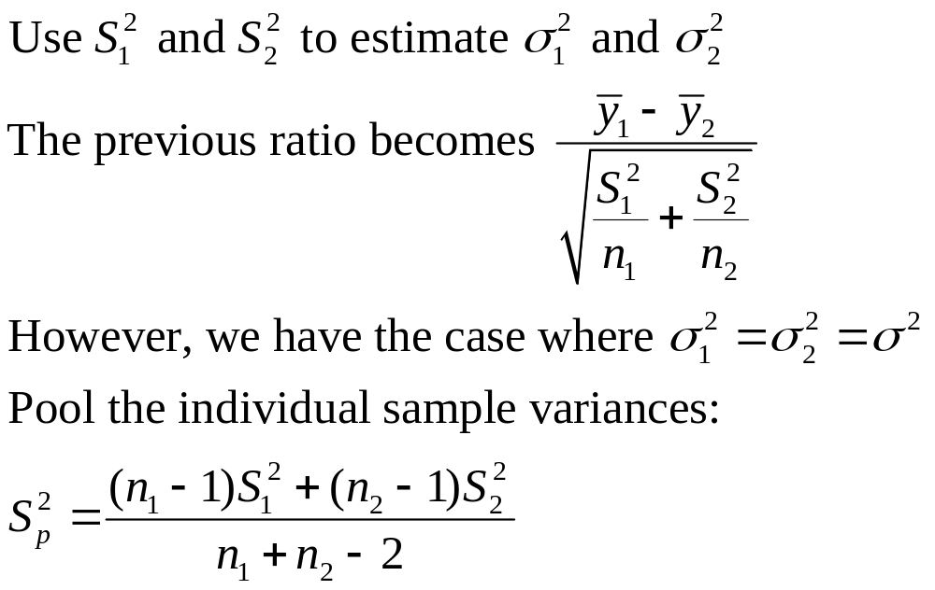
How the Two-Sample t-Test Works:
Chapter 2
Design & Analysis of Experiments 8E 2012 Montgomery

Slide 17
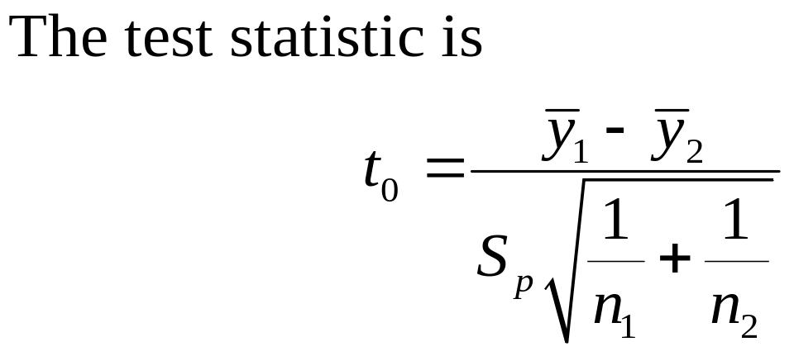
How the Two-Sample t-Test Works:
Values of t₀ that are near zero are consistent with the null hypothesis
Values of t₀ that are very different from zero are consistent with the alternative hypothesis
t₀ is a “distance” measure-how far apart the averages are expressed in standard deviation units
Notice the interpretation of t₀ as a signal-to-noise ratio
Chapter 2
Design & Analysis of Experiments 8E 2012 Montgomery

Slide 18
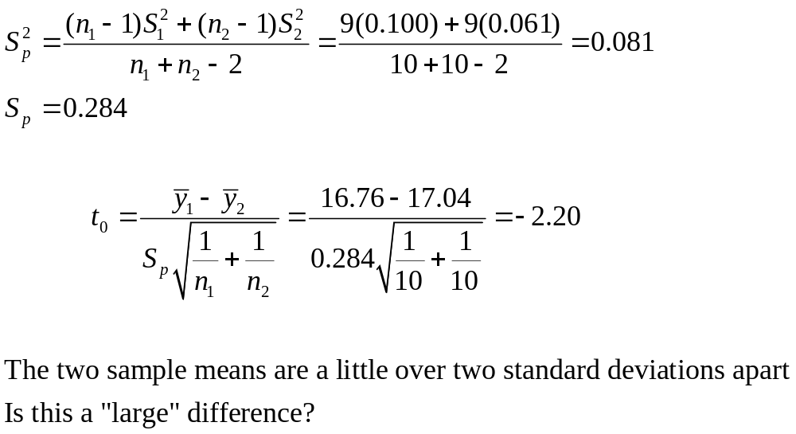
The Two-Sample (Pooled) t-Test
Chapter 2
Design & Analysis of Experiments 8E 2012 Montgomery

Slide 19
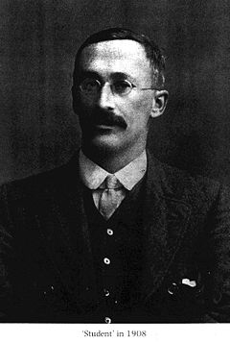
William Sealy Gosset (1876, 1937)
Gosset's interest in barley cultivation led him to speculate that design of experiments should aim, not only at improving the average yield, but also at breeding varieties whose yield was insensitive (robust) to variation in soil and climate.
Developed the t-test (1908)
Gosset was a friend of both Karl Pearson and R.A. Fisher, an achievement, for each had a monumental ego and a loathing for the other.
Gosset was a modest man who cut short an admirer with the comment that “Fisher would have discovered it all anyway.”
Chapter 2
Design & Analysis of Experiments 8E 2012 Montgomery

Slide 20
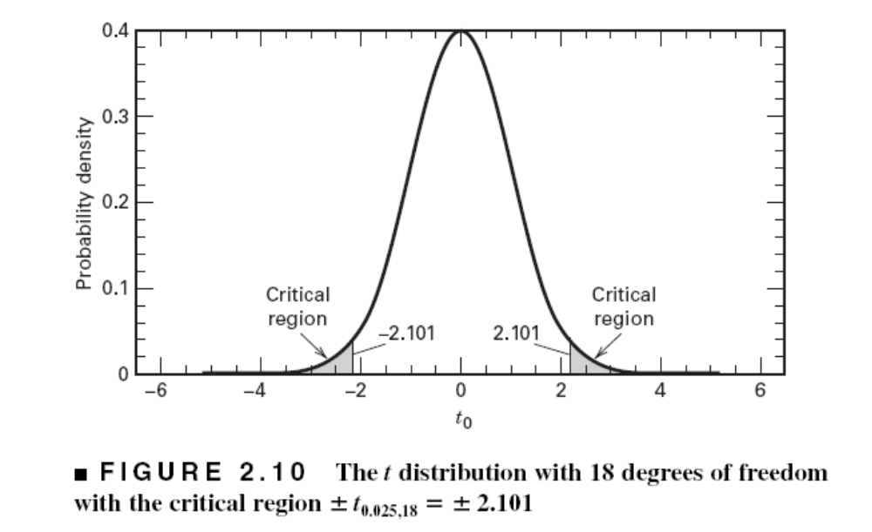
The Two-Sample (Pooled) t-Test
We need an objective basis for deciding how large the test statistic t₀ really is
In 1908, W. S. Gosset derived the reference distribution for t₀ … called the t distribution
Tables of the t distribution – see textbook appendix page 614
t₀ = -2.20
Chapter 2
Design & Analysis of Experiments 8E 2012 Montgomery

Slide 21
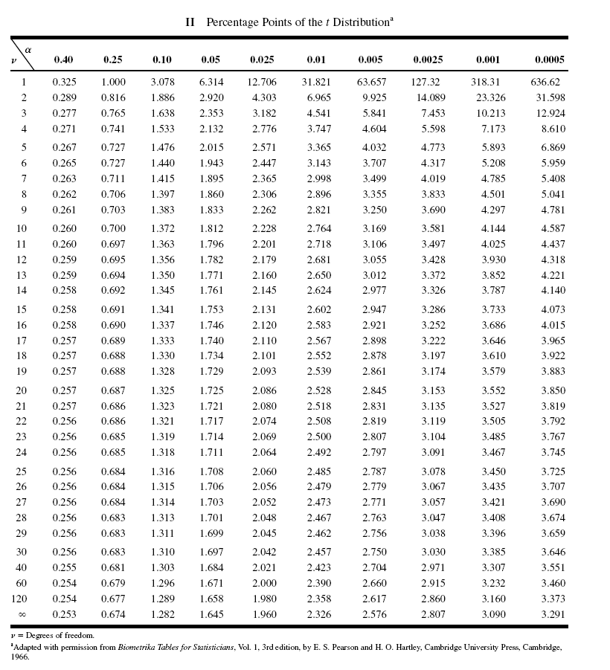
Chapter 2
Design & Analysis of Experiments 8E 2012 Montgomery

Slide 22
The Two-Sample (Pooled) t-Test
A value of t₀ between –2.101 and 2.101 is consistent with equality of means
It is possible for the means to be equal and t₀ to exceed either 2.101 or –2.101, but it would be a “rare event” … leads to the conclusion that the means are different
Could also use the P-value approach
t₀ = -2.20
Chapter 2
Design & Analysis of Experiments 8E 2012 Montgomery

Slide 23
The Two-Sample (Pooled) t-Test
t₀ = -2.20
The P-value is the area (probability) in the tails of the t-distribution beyond -2.20 + the probability beyond +2.20 (it’s a two-sided test)
The P-value is a measure of how unusual the value of the test statistic is given that the null hypothesis is true
The P-value the risk of wrongly rejecting the null hypothesis of equal means (it measures rareness of the event)
The exact P-value in our problem is P = 0.042 (found from a computer)
Chapter 2
Design & Analysis of Experiments 8E 2012 Montgomery

Slide 24
Approximating the P-value
Our t-table only gives probabilities greater than positive values of t. So take the absolute value of t₀ = -2.20 or |t₀|= 2.20.
Now with 18 degrees of freedom, find the values of t in the table that bracket this value.
These are 2.101 < |t₀|= 2.20 < 2.552. The right-tail probability for t = 2.101 is 0.025 and for t = 2.552 is 0.01. Double these probabilities because this is a two-sided test.
Therefore the P-value must lie between these two probabilities, or
0.05 < P-value < 0.02
These are upper and lower bounds on the P-value.
We know that the actual P-value is 0.042.
Chapter 2
Design & Analysis of Experiments 8E 2012 Montgomery

Slide 25
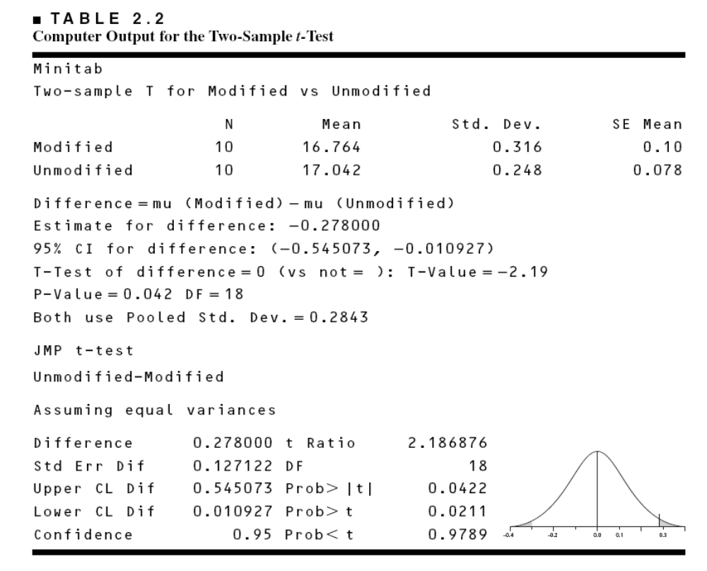
Computer Two-Sample t-Test Results
Chapter 2
Design & Analysis of Experiments 8E 2012 Montgomery

Slide 26
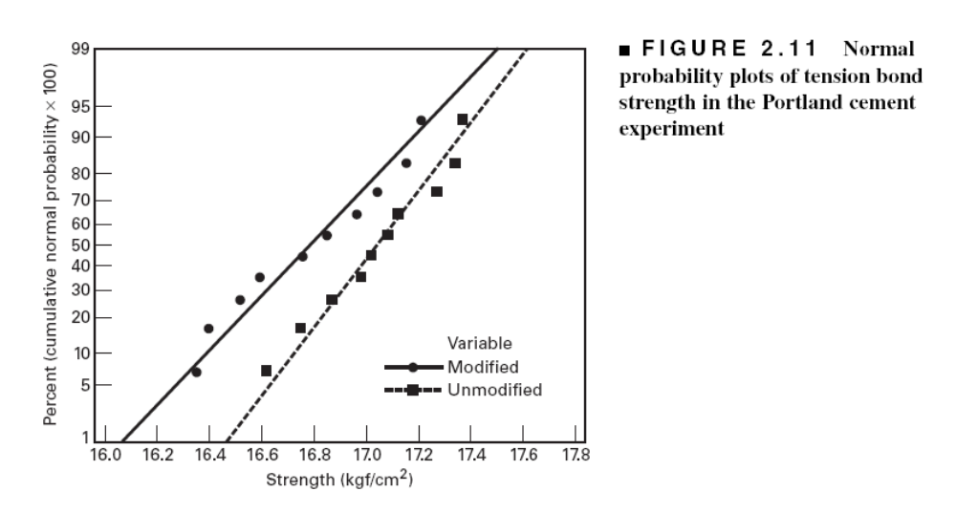
Checking Assumptions –
The Normal Probability Plot
Chapter 2
Design & Analysis of Experiments 8E 2012 Montgomery

Slide 27
Importance of the t-Test
Provides an objective framework for simple comparative experiments
Could be used to test all relevant hypotheses in a two-level factorial design, because all of these hypotheses involve the mean response at one “side” of the cube versus the mean response at the opposite “side” of the cube
Chapter 2
Design & Analysis of Experiments 8E 2012 Montgomery

Slide 28
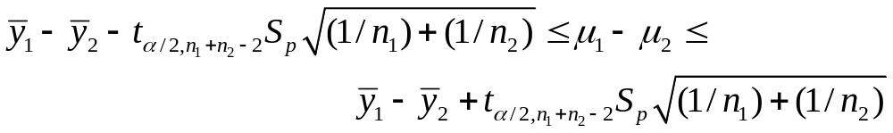
Confidence Intervals (See pg. 43)
Hypothesis testing gives an objective statement concerning the difference in means, but it doesn’t specify “how different” they are
General form of a confidence interval
The 100(1- α)% confidence interval on the difference in two means:
Chapter 2
Design & Analysis of Experiments 8E 2012 Montgomery

Slide 29
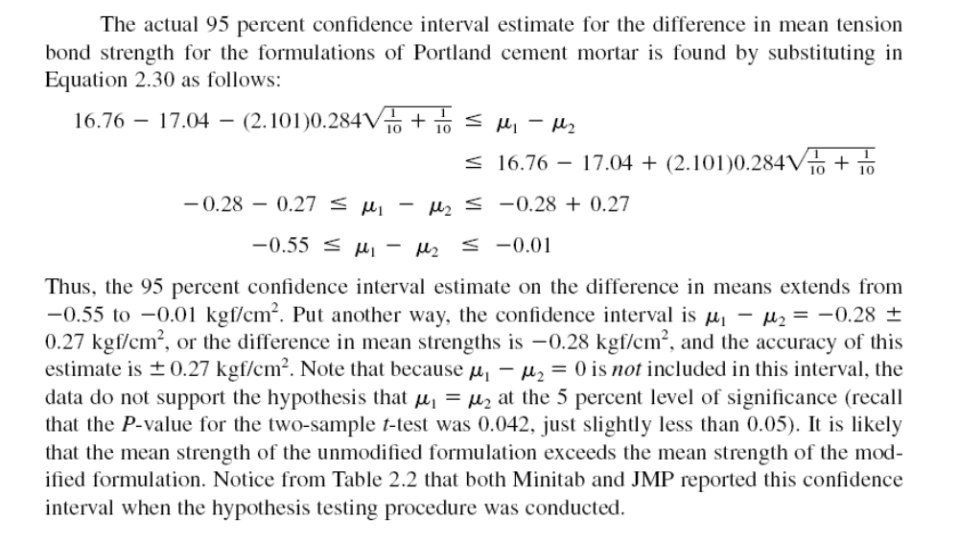
Chapter 2
Design & Analysis of Experiments 8E 2012 Montgomery

Slide 30
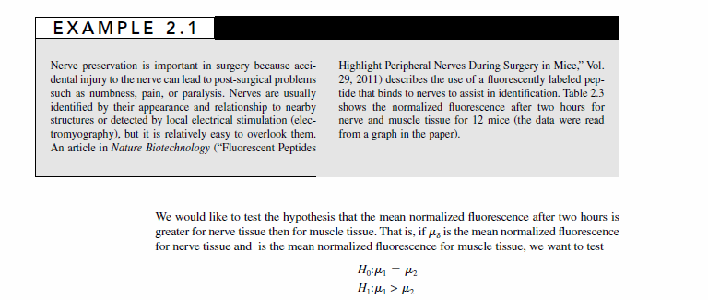
What if the Two Variances are Different?
Chapter 2
Design & Analysis of Experiments 8E 2012 Montgomery

Slide 31
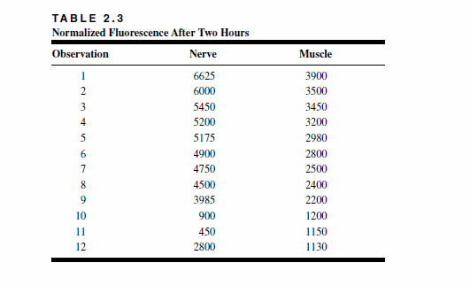
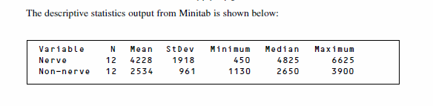
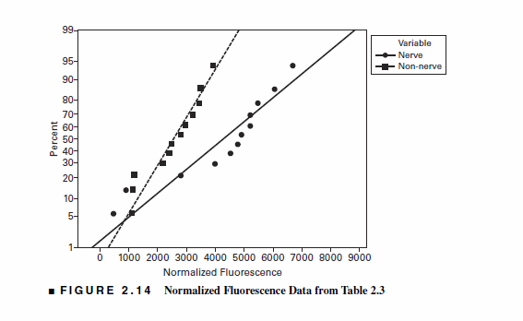
Chapter 2
Design & Analysis of Experiments 8E 2012 Montgomery

Slide 32
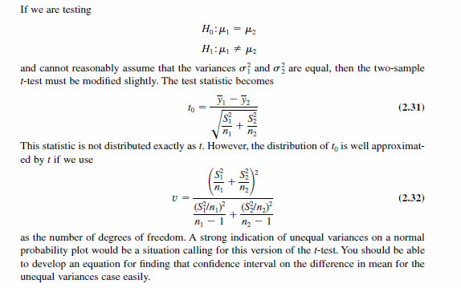
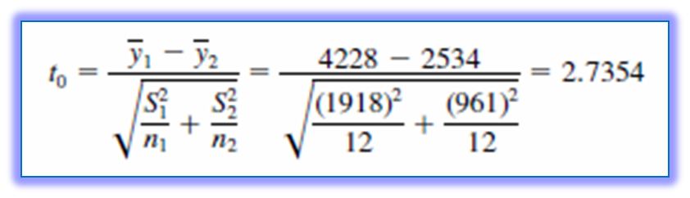
Chapter 2
Design & Analysis of Experiments 8E 2012 Montgomery

Slide 33
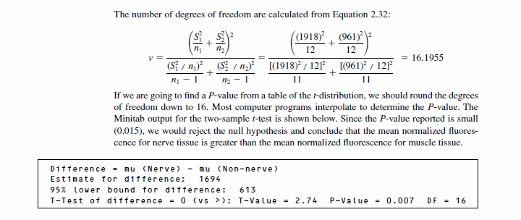
Chapter 2
Design & Analysis of Experiments 8E 2012 Montgomery

Slide 34
Other Chapter Topics
Hypothesis testing when the variances are known
One sample inference (t and Z tests)
Hypothesis tests on variances (F tests)
Paired experiments – this is an example of blocking
Chapter 2
Design & Analysis of Experiments 8E 2012 Montgomery

